Slide 1

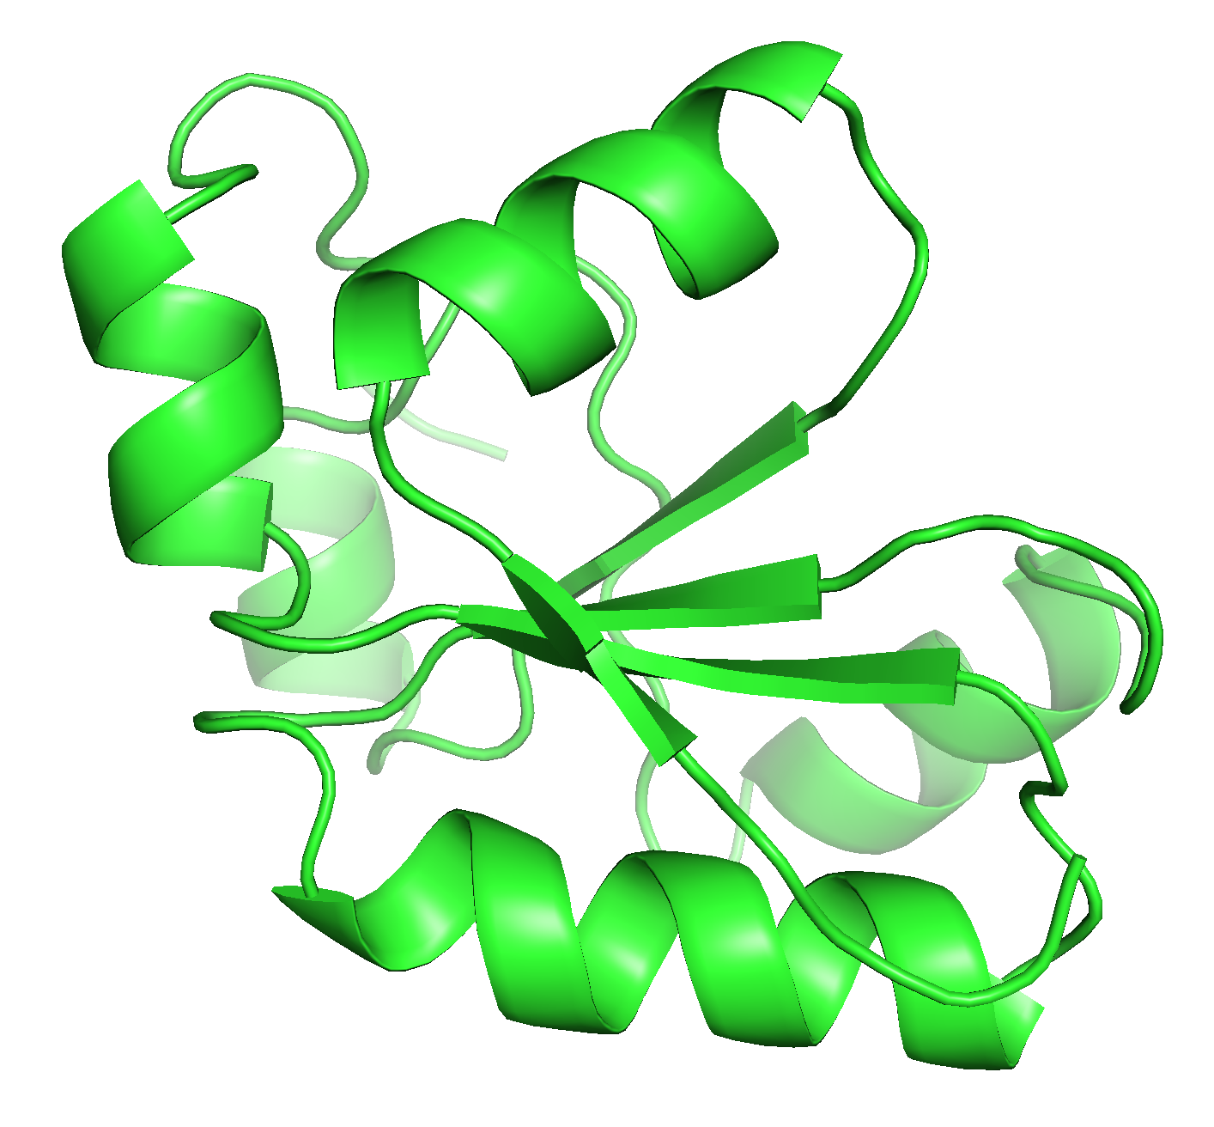
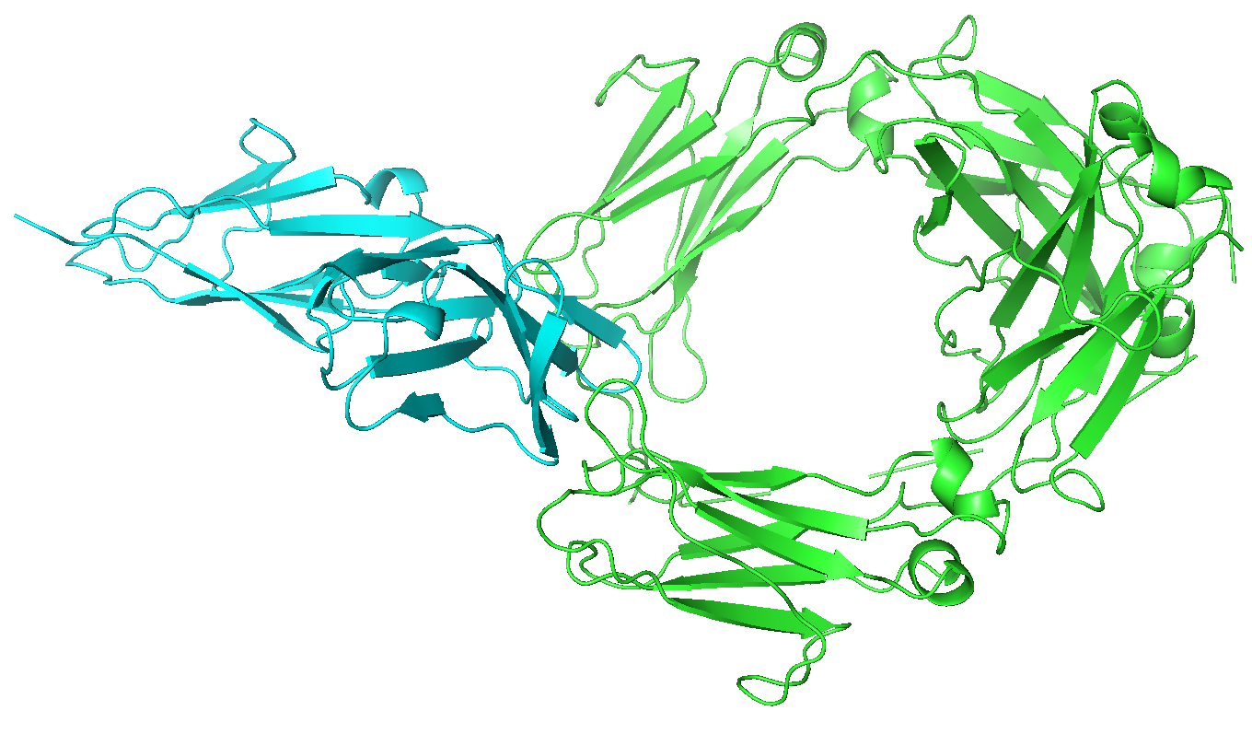
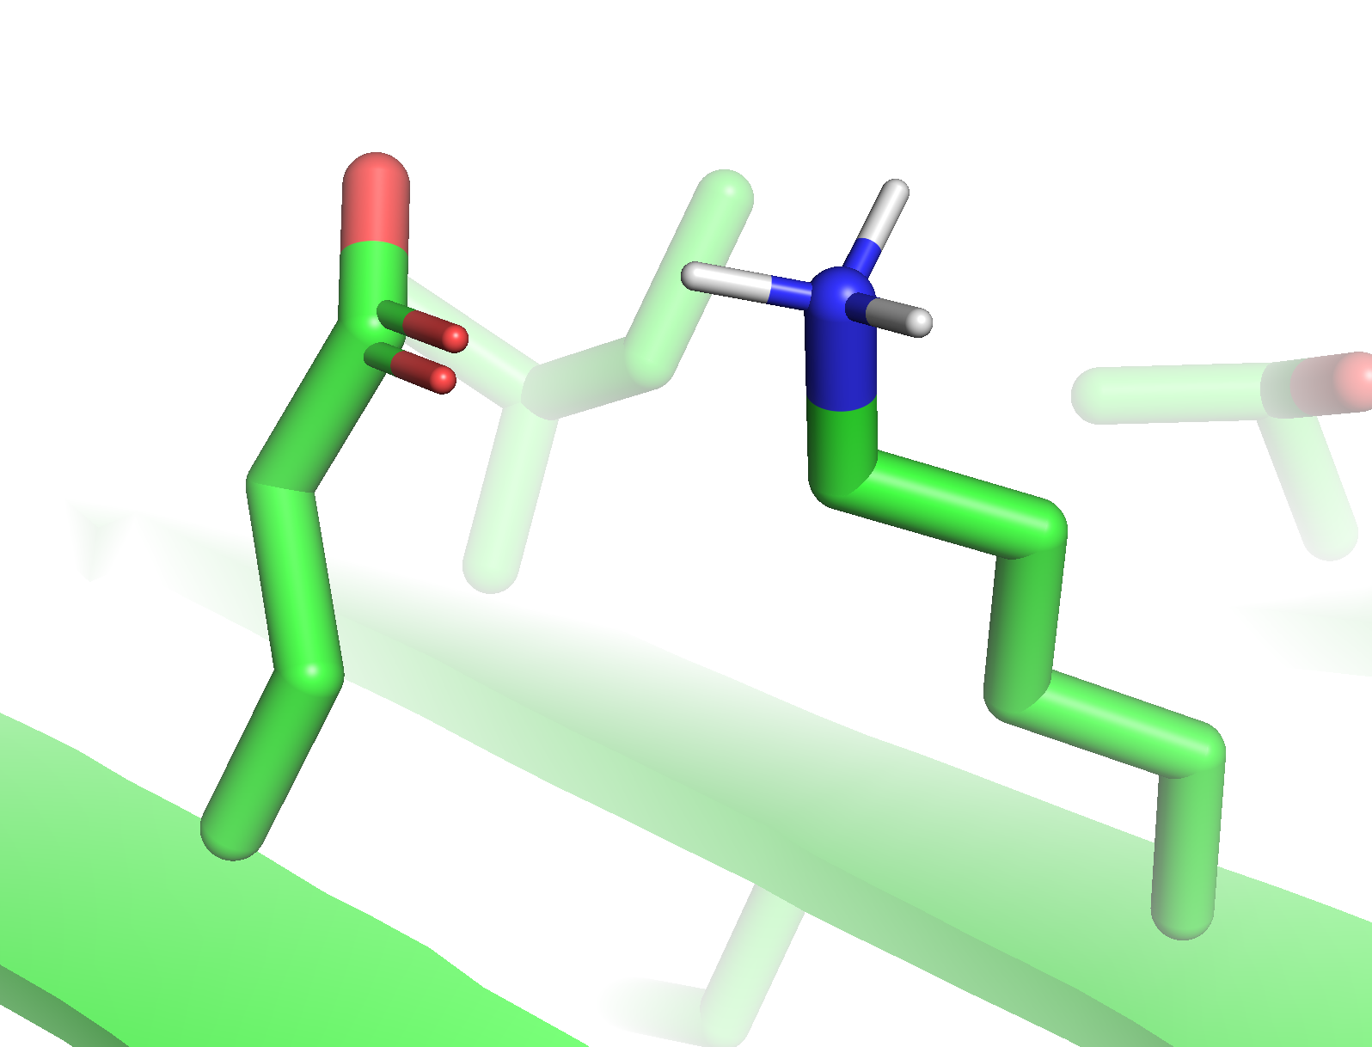
A
Top track: direct reparameterization using experimental data on designs
Experimental data on designs
Update energy function
Bottom track: use experimental data on designs to identify problems; reparameterization on high-quality benchmarks
Detect recurrent failure modes
Identify corresponding failures in high-quality benchmarks
B
Identified problem
Relevant benchmark
steric clashes
Relaxing high-resolution crystal structures
Predicting native protein-protein interfaces
underweighting the cost of burying polar atoms
Predicting solvation energies of side chains
overweighting electrostatic interactions
Predicting the effects of single amino-acid mutations
+
-

Slide 2
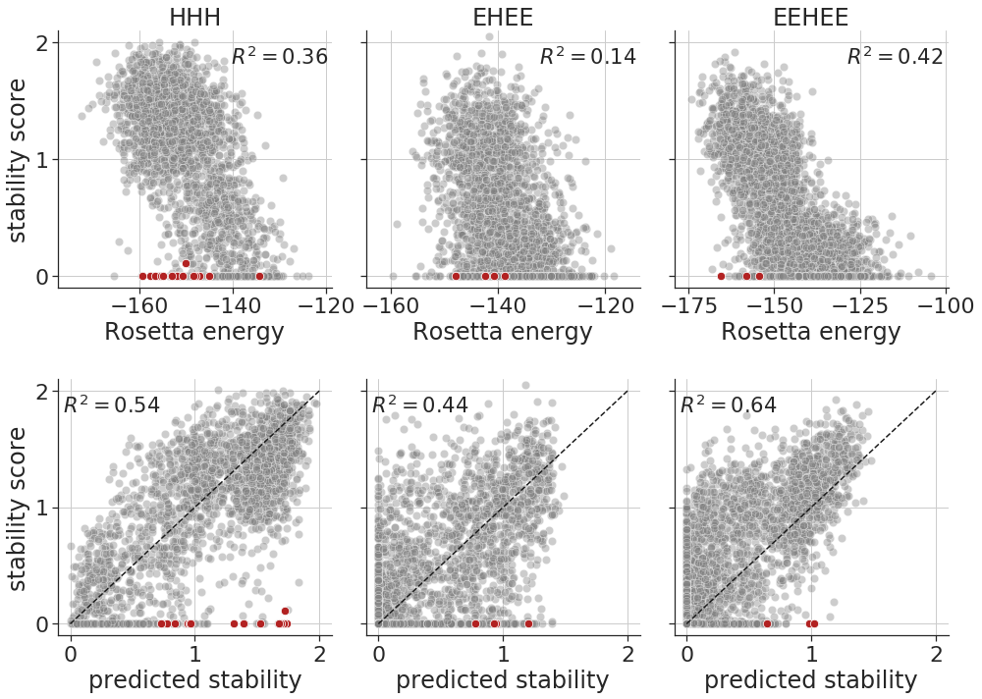
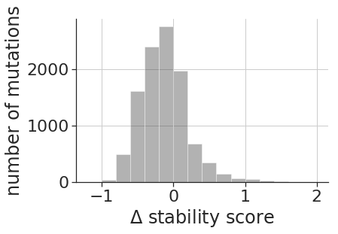
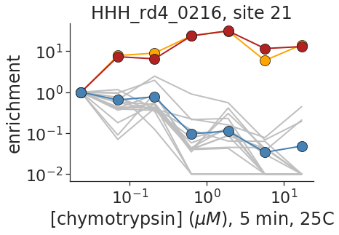
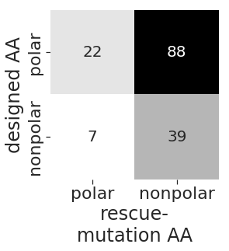
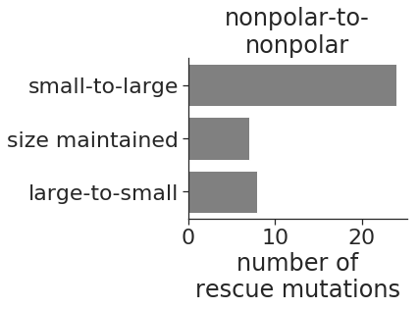
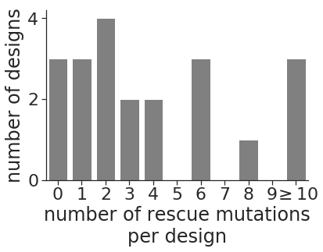
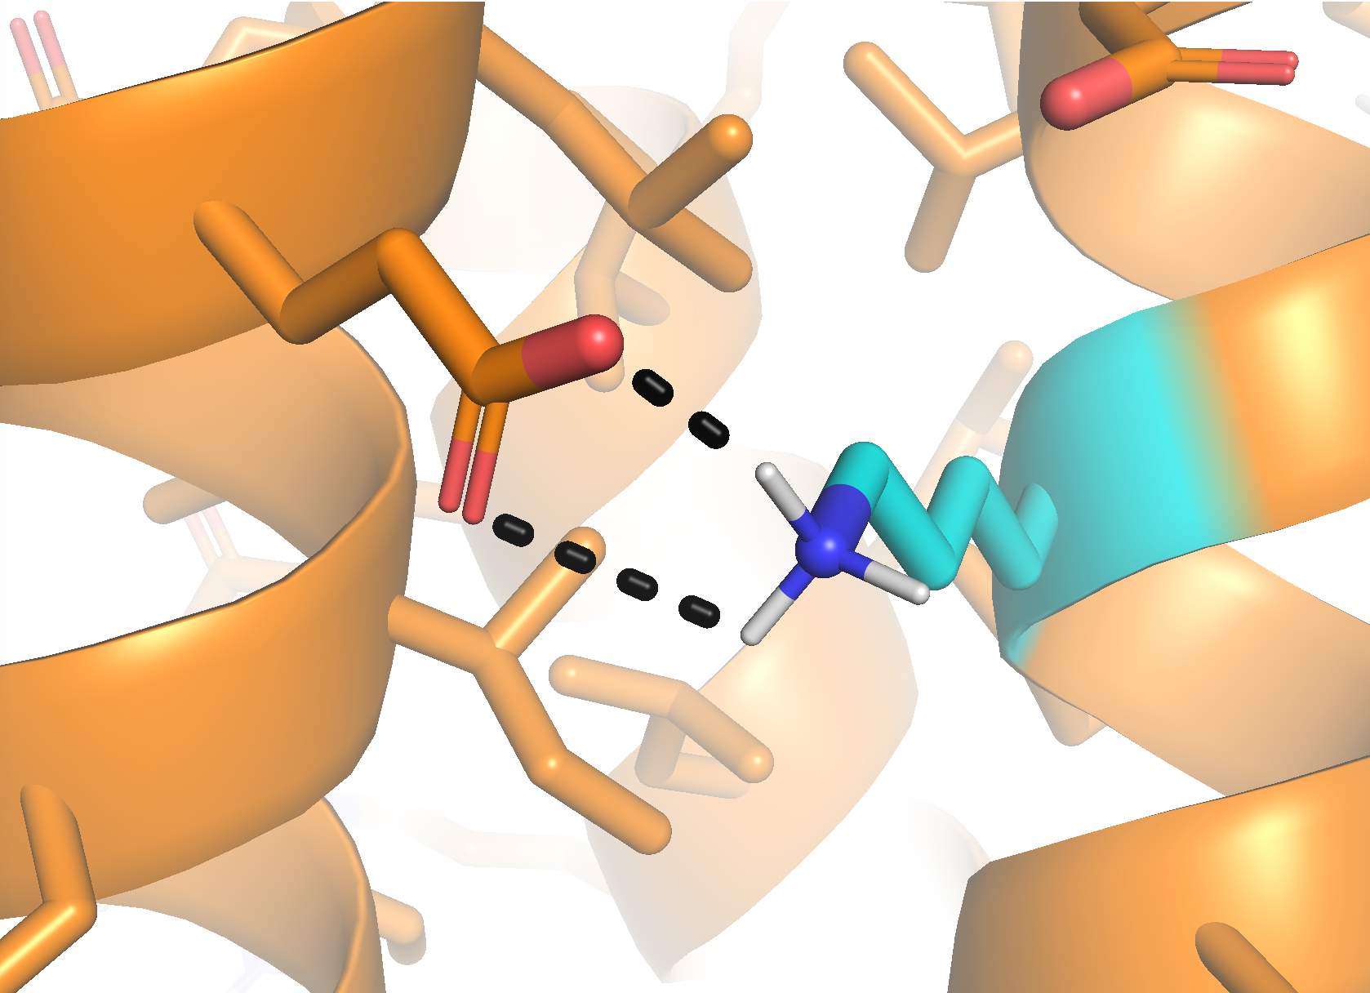
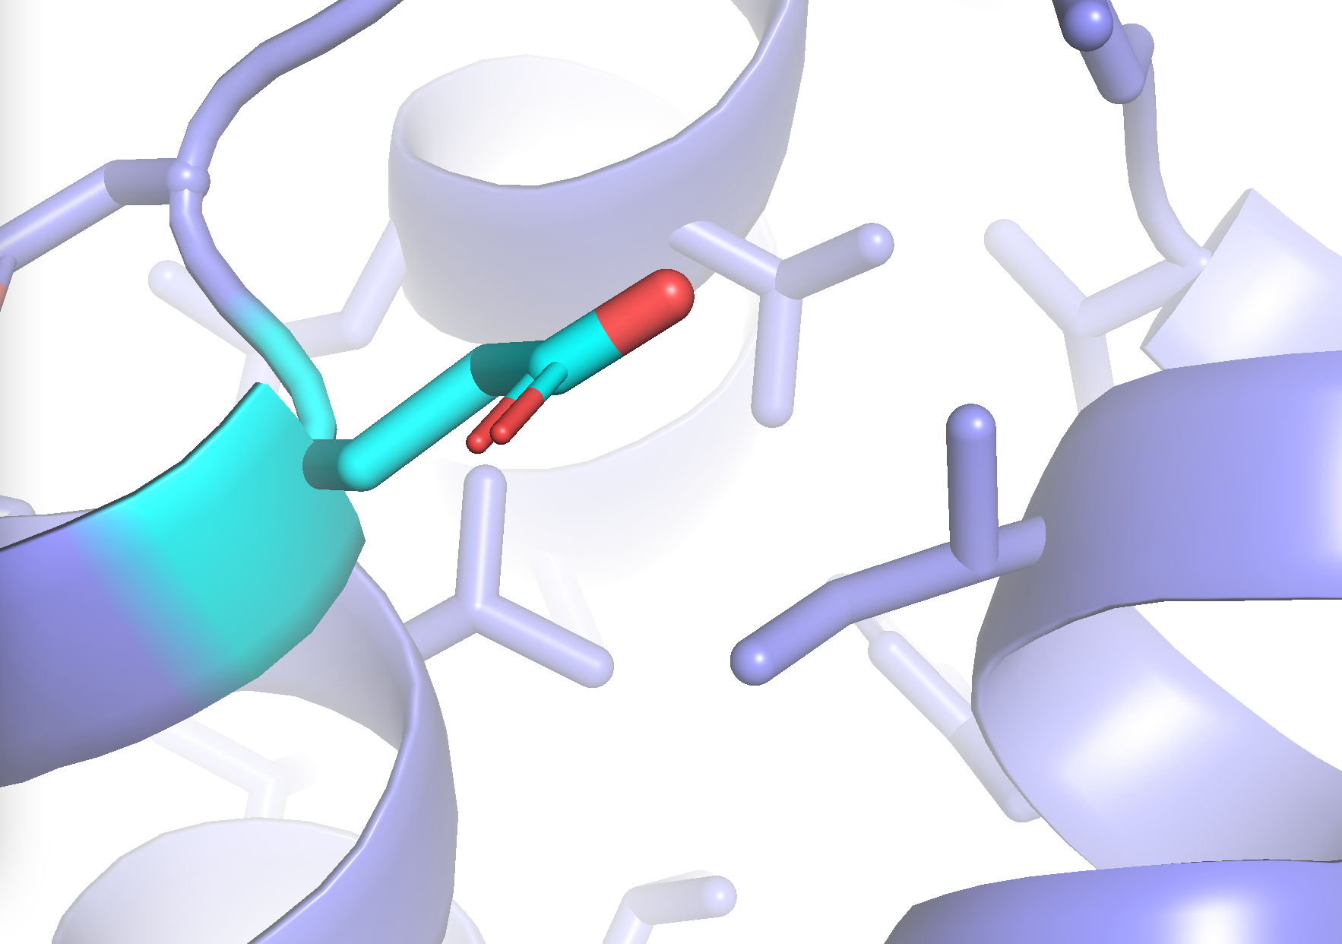
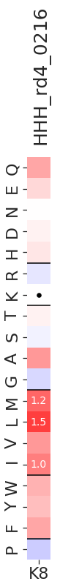
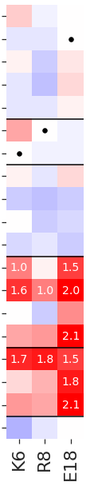
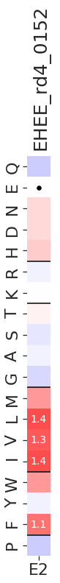
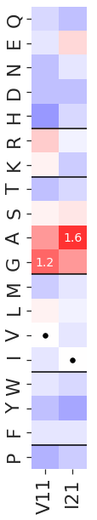
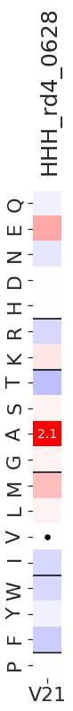
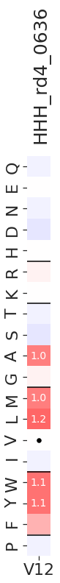
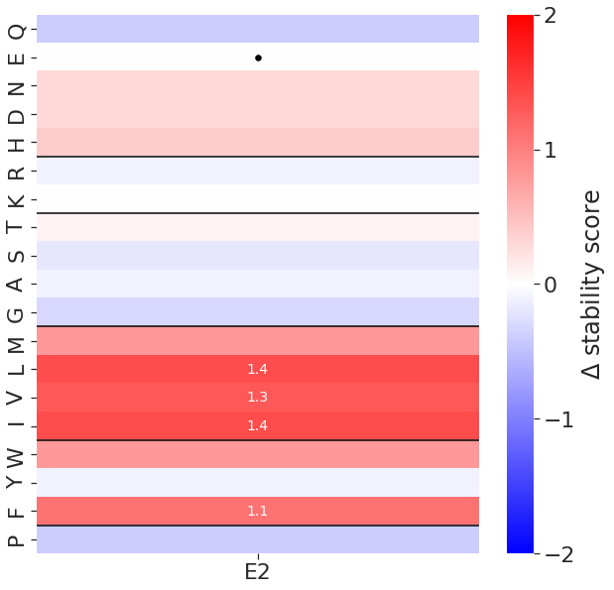
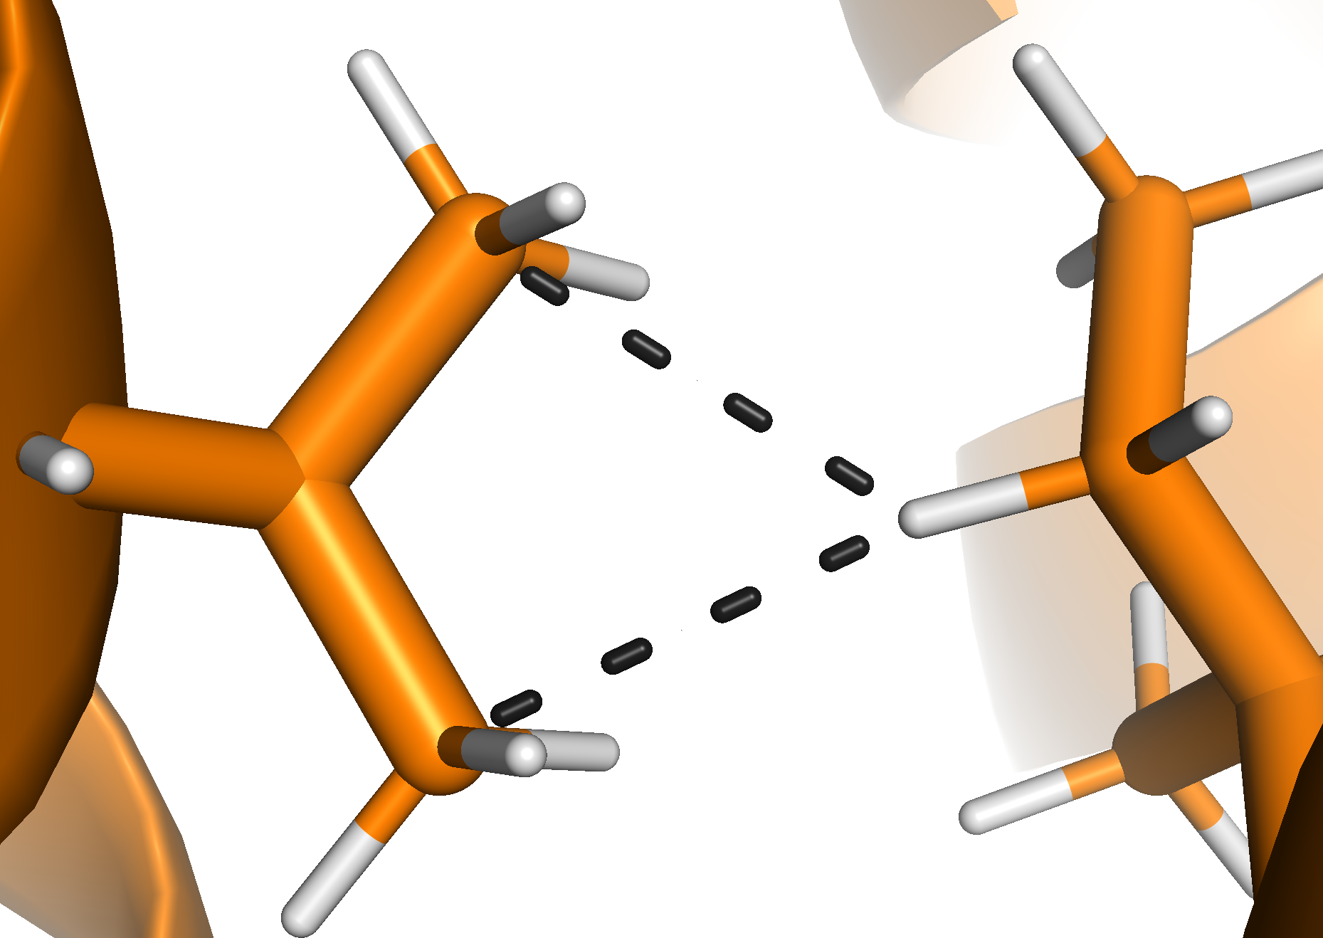
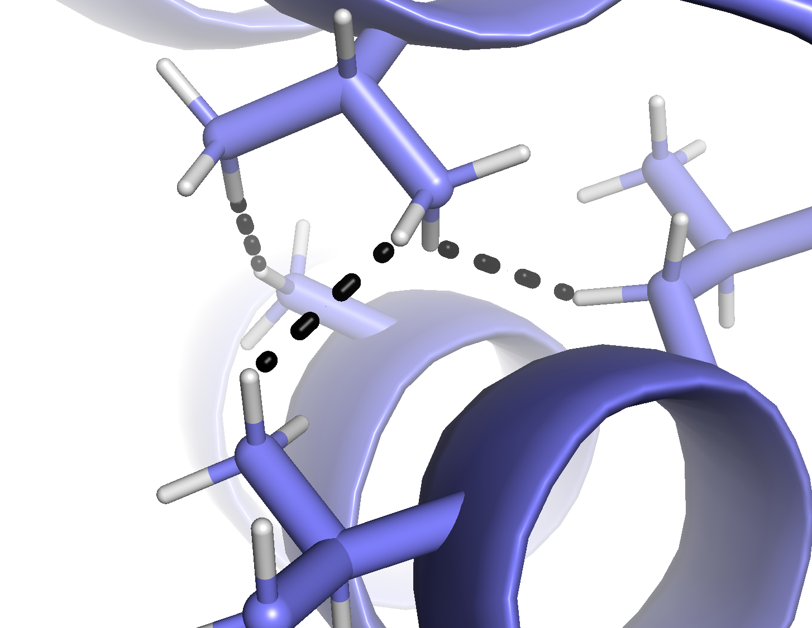
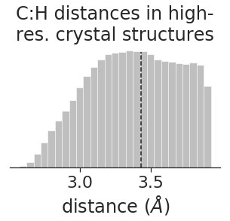
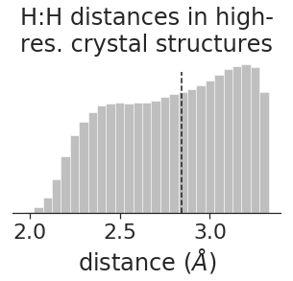
For these plots, should I clip stability scores at zero?
V12 interesting; differs from the V21 pattern; could be due to clashing in beta-branched amino acids
A
B
C
I21G
I21A
rescue mutations
(~1%)
WT
D
E
F
G
H
HHH_rd4_0216
HHH_rd4_0628
examples of sites with…
polar-to-nonpolar rescue mutations
large-to-small rescue mutations
E18
design:
K8
I
HHH_rd4_0216
HHH_rd4_0628
C:H clashing
H:H clashing
V11
I21
amino acid
2.7 Å
V21
all
2.2 Å
2.7 Å
J
C:H distances
H:H distances
2.2 Å
2.7 Å
site
site
Notes:
To do:
additional picture
0628 has a pair of Hs that are very close

Slide 3
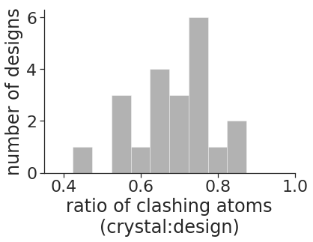
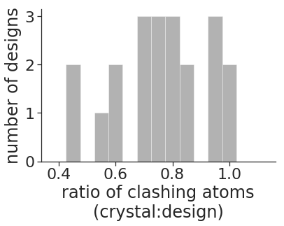
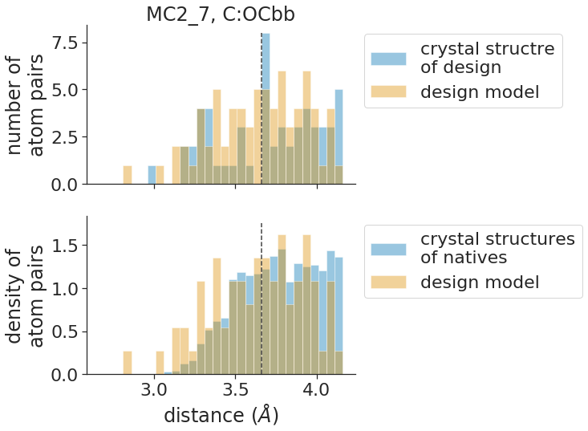
A
C:C
B
C:OCbb
C
MC2_7
crystal structure of design
design model

Slide 4
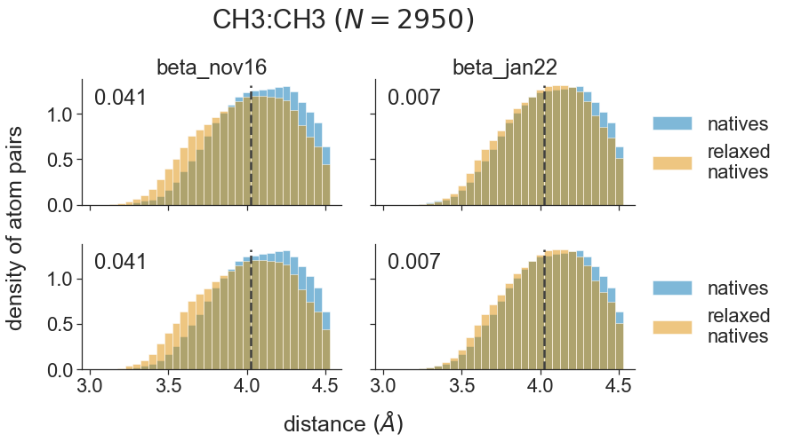
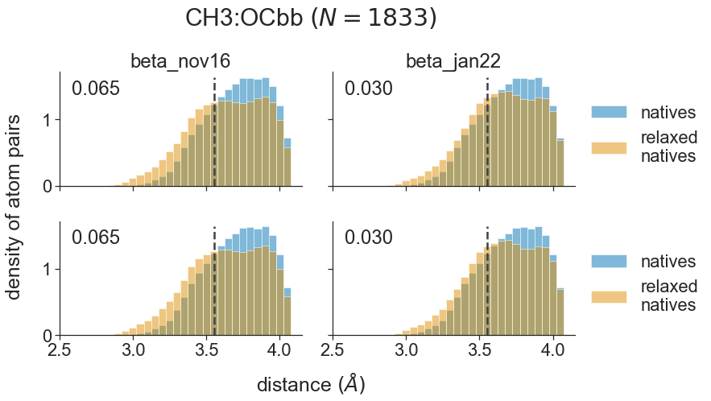
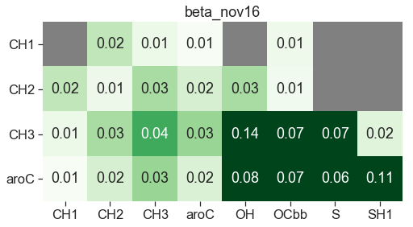
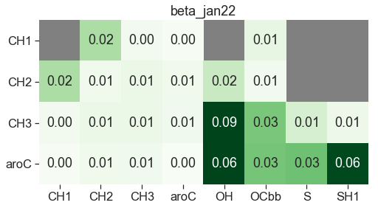
A
CH3:CH3
CH3:OCbb
density of atom pairs
B
C

Slide 5
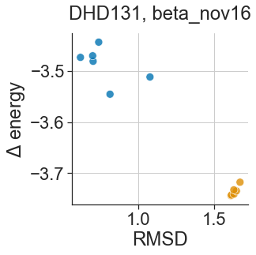
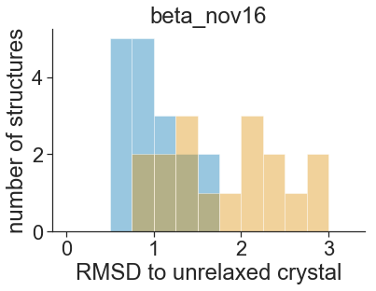
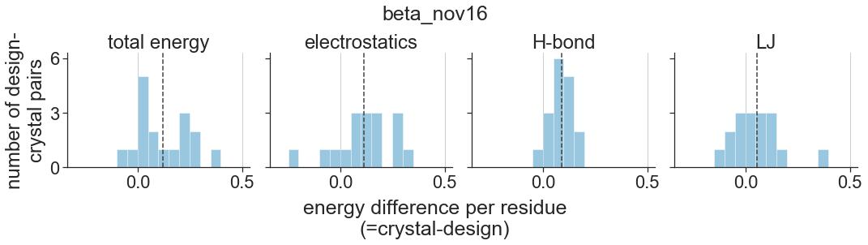
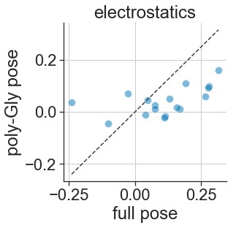
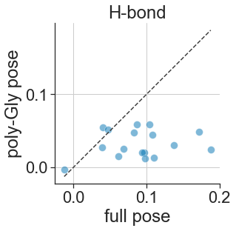
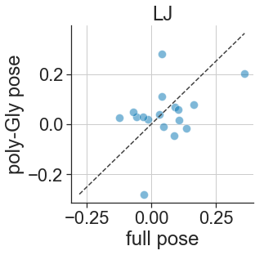
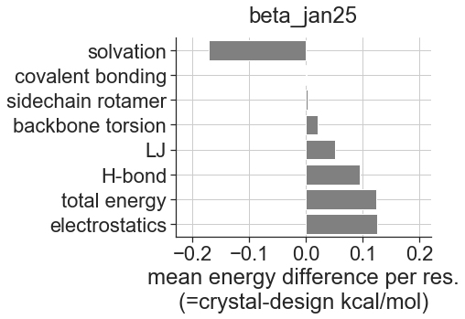
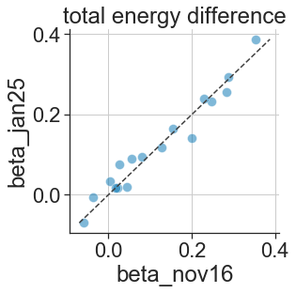
A
B
replicate relaxes of crystal structure
relax replicates of design model
relaxed crystal
relaxed design
C
D
E
F

Slide 7
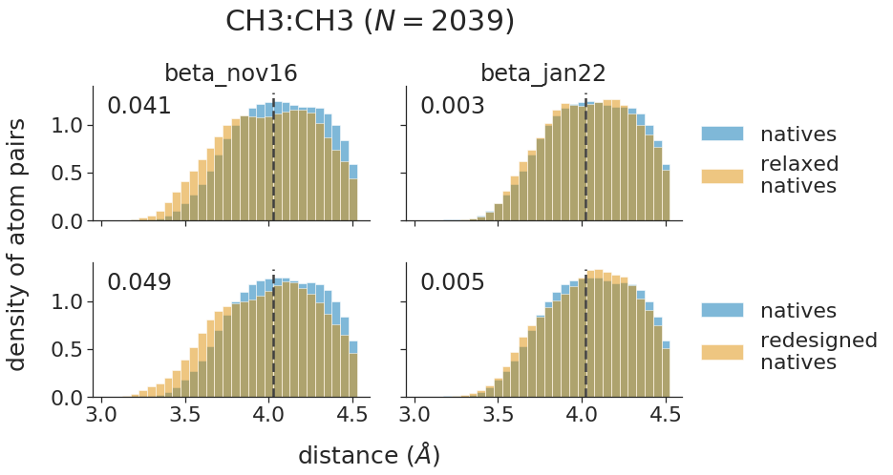
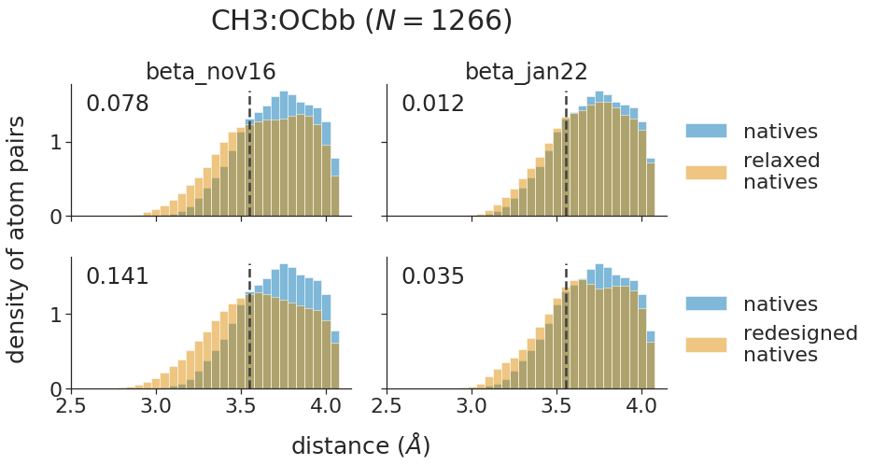
To do:
plot validation data instead of testing data
A
CH3:CH3
CH3:OCbb
B
C:C
C
C:OCbb

Slide 8
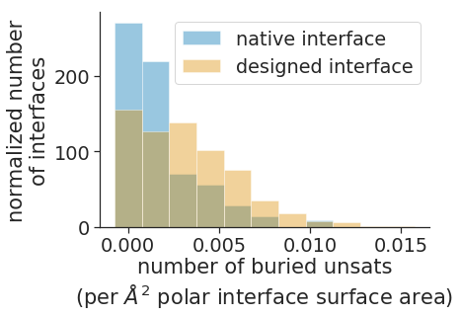
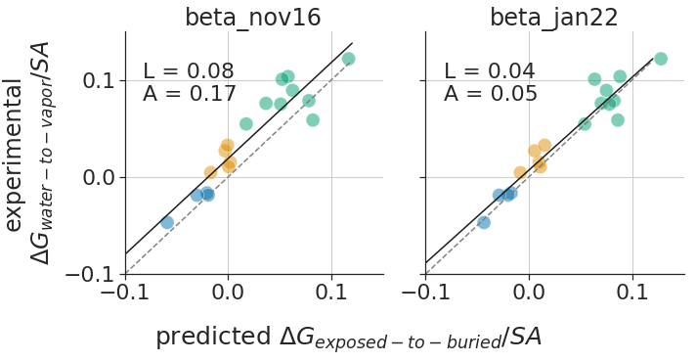
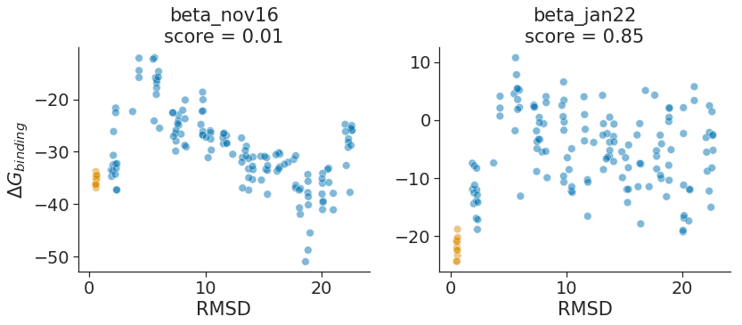
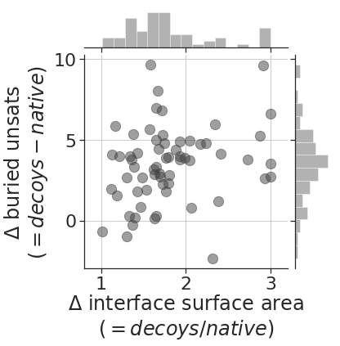
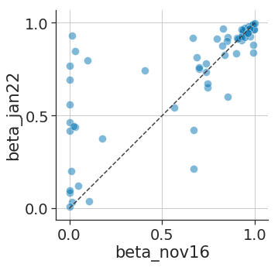
To do:
update PPI benchmark data from long relax
plot data for difference in size of energy gaps
drop the training data
A
B
polars
FWYCM
AVLI
C
D
E

Slide 9
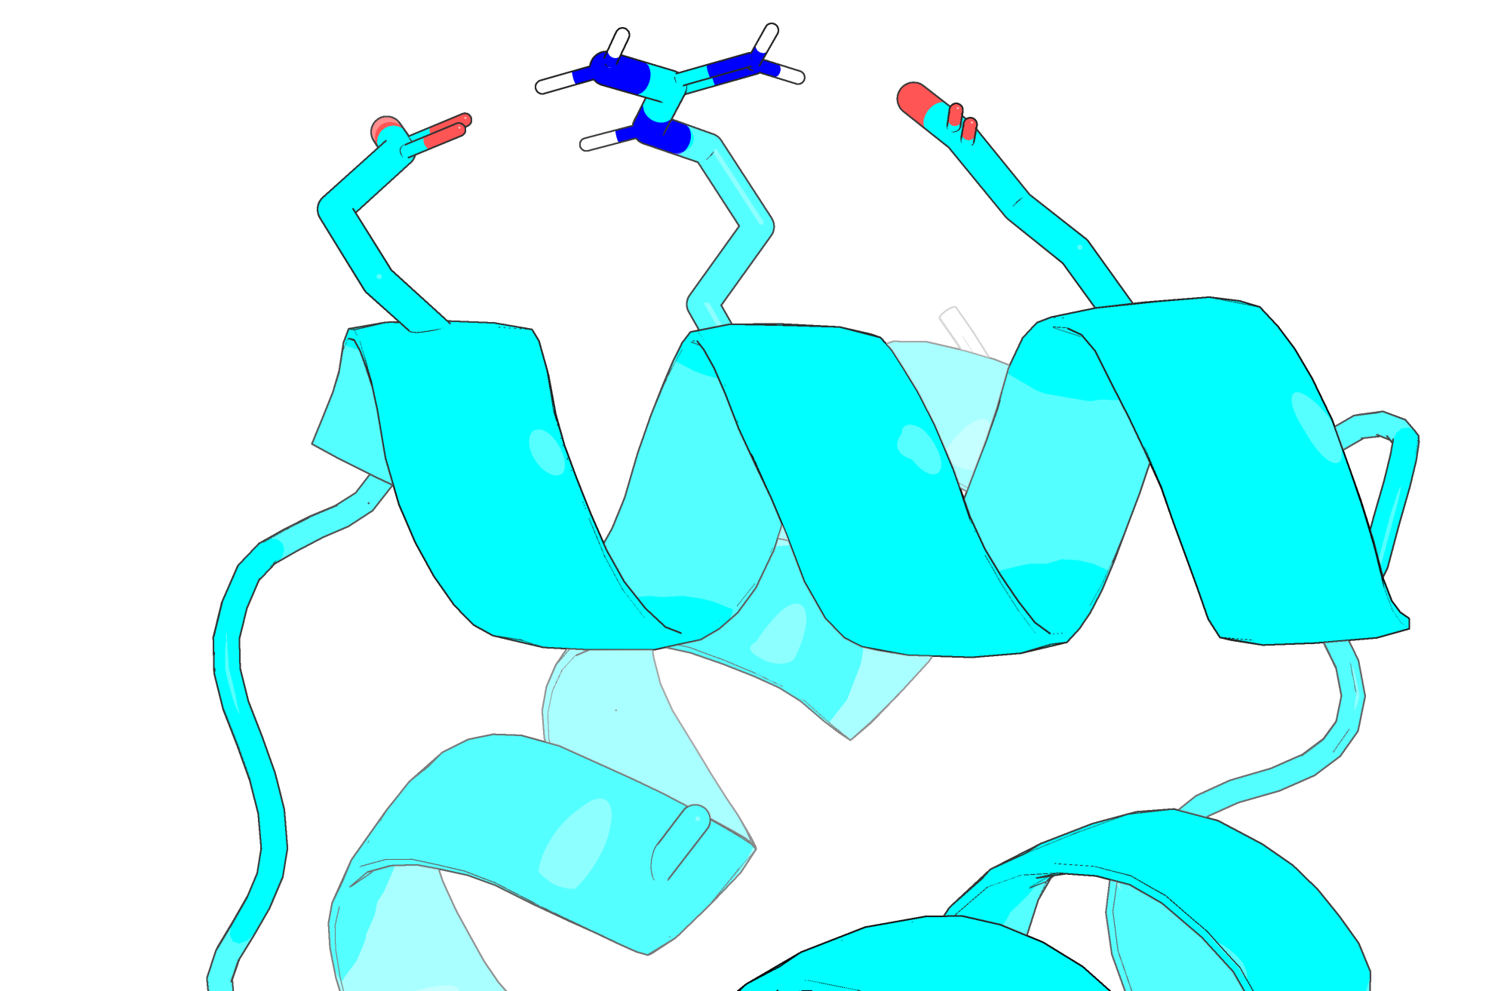
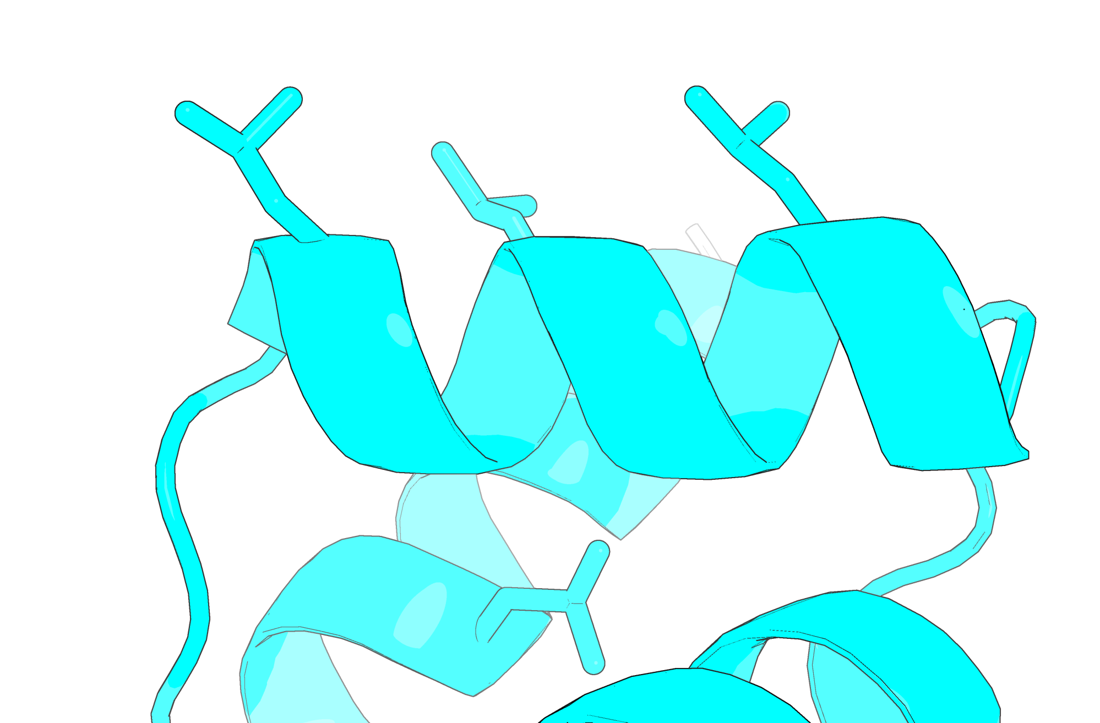
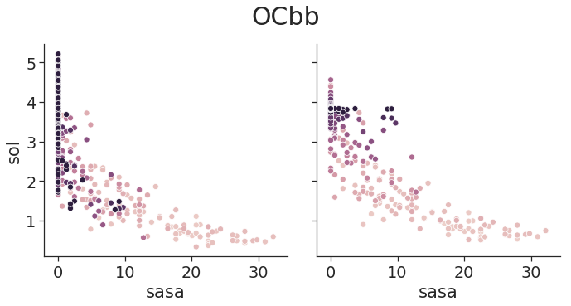
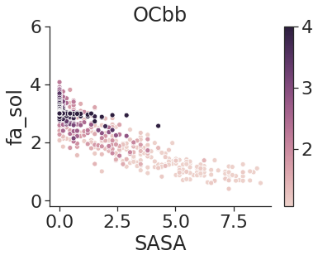
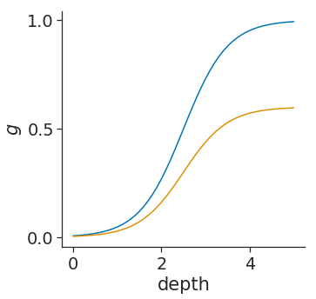
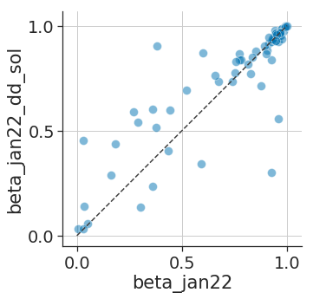
To do:
A
B
probe
poly-leucine molecular surface
depth
SASA = 0
high packing density
E ≈ 5 energy units
SASA = 0
low packing density
E ≈ 2 energy units
C
D
E
uncorrected
energies
depth-corrected
energies
high depth
switching function
desolvation energy
low depth
SASA
SASA

Slide 10






changes titles on plots to indicate that it’s changing jan22 functional form
Make figure in D with a fixed-backbone design protocol, with number of H-bonds? with relaxed structures to make sure it isn’t just design?
add a supplemental figure with many examples of C (Hfuse, NTF2, etc.)
A
B
C
relaxed from crystal
relaxed from design
relaxed design
relaxed crystal
D
E
poly-leucine molecular surface
probe
depth
F
G
relaxed from crystal
relaxed from design
Figure 4. Experimentally testing designs suggests that Rosetta over-weights the strength of electrostatic interactions
Notes:
B aligned on K17

Slide 12

changes titles on plots to indicate that it’s changing jan22 functional form
Make figure in D with a fixed-backbone design protocol, with number of H-bonds? with relaxed structures to make sure it isn’t just design?
add a supplemental figure with many examples of C (Hfuse, NTF2, etc.)
A
B
C
relaxed from crystal
relaxed from design
relaxed design
relaxed crystal
D
E
F
G
relaxed from crystal
relaxed from design
Figure 4. Experimentally testing designs suggests that Rosetta over-weights the strength of electrostatic interactions
Notes:
B aligned on K17

Slide 13
To do:
A
B
probe
poly-leucine molecular surface
depth
SASA = 0
high packing density
E ≈ 5 energy units
SASA = 0
low packing density
E ≈ 2 energy units
C
D
E
uncorrected
energies
depth-corrected
energies
high depth
switching function
desolvation energy
low depth
SASA
SASA

Slide 15








To do:
replace A with some kind of comparison
turn C into bar plot; choose something that covers the whole RMSD range
plot data for difference in size of energy gaps
recompute numbers with Brian’s buried unsat filter
check SASA values of H atoms from NH groups
move lines to main plot
drop the training data
A
B
*
*
*
polars
*
*
*
FWYCM
AVLI
binder design
FGFR2 target
binder design
SARS-CoV-2 RBD target
C
1E4K
D
E
training data
testing data
1E4K
1E4K

